Slide 1
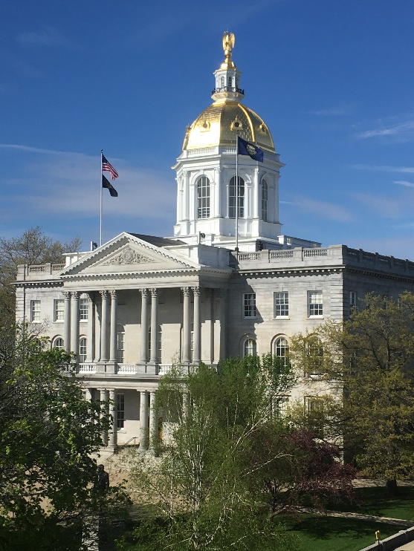
Lobbying and Advocacy: A Primer for New Hampshire Non-Profit Advocates February 15, 2018

Slide 2
Objectives
Identify the legal sources of lobbying restrictions
Define and describe advocacy, direct lobbying, and grassroots lobbying and the difference between these terms
Describe federal lobbying restrictions and the impact these restrictions have on public health officials and advocates in non-profits
Describe New Hampshire laws relative to lobbying and advocacy

Slide 3
How to Get Public Health Advocacy Done in New Hampshire without Violating the Law
Kerri McGowan Lowrey, JD, MPH
Network for Public Health Law – Eastern Region
Lobbying and Advocacy: A Primer for New Hampshire Non-Profit Advocates
February 15, 2018
University of New Hampshire School of Law

Slide 4
Disclaimer
The Network for Public Health Law is a national initiative of the Robert Wood Johnson Foundation.
This presentation was developed by Kerri McGowan Lowrey, Deputy Director, Kathleen S. Hoke, Director, and William C. Tilburg, Senior Staff Attorney for the Network for Public Health Law. The Network for Public Health Law provides information and technical assistance on issues related to public health law. The legal information and assistance provided in this presentation does not constitute legal advice or legal representation. For legal advice, please consult New Hampshire legal counsel.

Slide 5
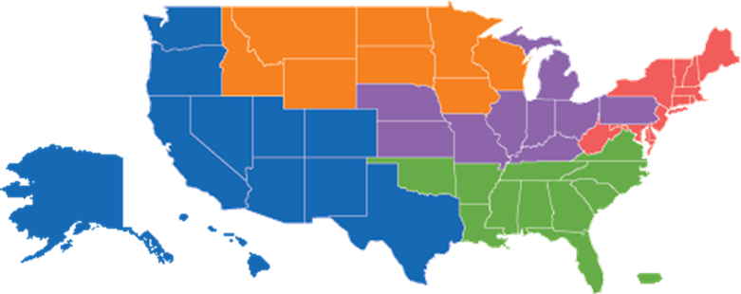
What is the Network?
Funded by Robert Wood Johnson Foundation
The mission of the Foundation is to improve the health and health care of all Americans.
One National Coordinating Center
Donna Levin, Executive Director
Five Regional Offices
Northern, Western, Mid-States, Southeastern, Eastern
Three Program Partners
Policies in Action (Formerly the Public Health Law Research Program)
ChangeLab Solutions
Public Health Law Center/Tobacco Control Legal Consortium

Slide 6
Northern Region
Tobacco control, cross-border issues, mental health
Western Region
Emergency legal preparedness and response, Tribal law
Mid-States Region
Health information data sharing; public health regulation (HIPAA)
Southeastern Region
Accreditation and structure of public health agencies, health reform (ACA)
Eastern Region
Food safety, environmental health, injury prevention, marijuana, school health

Slide 7
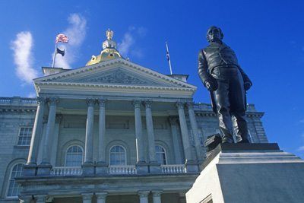
Roadmap
What is lobbying?
How is lobbying restricted?
What is allowed?
What if…

Slide 8
Competing Realities
Need to promote and protect the public’s health
Stagnant or shrinking budgets
Greater demand than ever for evidence-based solutions
Population-level change often requires policy change
Nurses, other health care providers, and community health advocates are uniquely qualified to advocate for the community’s health and to educate policymakers

Slide 9
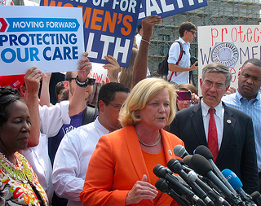
Competing Realities
Observe restrictions on lobbying
Recipients of federal funds
Nonprofit organizations
State/tribal/local restrictions

Slide 10
There is usually a way to get advocacy work done without violating the law…

Slide 11
Definitions
Merriam-Webster Definitions:
Lobbying
“To conduct activities aimed at influencing public officials and especially members of a legislative body on legislation.”
Advocacy
“The act or process of supporting a particular cause or proposal.”
…So what’s the difference?

Slide 12
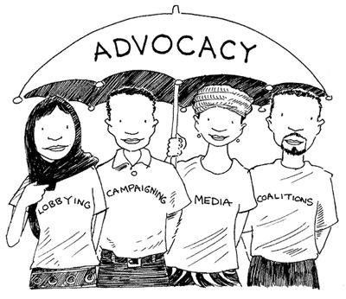
Advocacy vs. Lobbying
While all lobbying is advocacy, not all advocacy is lobbying
Advocacy and lobbying are similar, and the distinction is not always clear.
Instead of trying to distinguish between advocacy and lobbying, we’re going to determine:
The federal and state restrictions on lobbying, and
Given these restrictions, what is allowed

Slide 13
Restrictions on Lobbying
Lobbying Disclosure Act, 2 U.S.C. § 1605
Anti-Lobbying Act, 18 U.S.C. § 1913
Internal Revenue Code
Federal Consolidated Appropriations Act § 503
State and Local Laws
Notes:
Intro all five, then brief overview of LDA and ALA and then specify that we won’t be covering those, that we will be looking at IRC and Appropriations restrictions because they are most relevant for public health and then Jimwill cover state restrictions.

Slide 14
Two Main Factors:
Nature of Employer
Government
Non-profit
Source of Funds
Federal government
State or local government
Private

Slide 15
Internal Revenue Code

Slide 16
Internal Revenue Code
Limits, but does not prohibit, nonprofits from lobbying
“In general, no organization may qualify for section 501(c)(3) status if a substantial part of its activities is attempting to influence legislation (commonly known as lobbying). A 501(c)(3) may engage in some lobbying, but too much lobbying activity risks loss of tax-exempt status.” – IRS website
What is substantial?
Case-by-case determination made by time and money spent by organization on lobbying
Devoting less than 5% of activities to lobbying is not substantial
Notes:
Nonprofit organizations that qualify for federal income tax exemption as public charities, or 501(c)(3)s, have a favorable tax status, but are also subject to heightened restrictions on lobbying and other political activities.

Slide 17
Internal Revenue Code
Alternatively, non-profits may choose to have their lobbying activities analyzed under 501(h)
Provides for a sliding scale of amounts that can be spent on lobbying with a $1M cap
Provides clear expenditure limits
Shows IRS that organization is aware of lobbying limits (not likely to increase likelihood of audit)
Penalty tax, rather than loss of tax-exempt status, for exceeding limits
Notes:
Nonprofit organizations that qualify for federal income tax exemption as public charities, or 501(c)(3)s, have a favorable tax status, but are also subject to heightened restrictions on lobbying and other political activities.

Slide 18
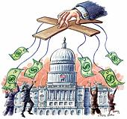
Direct Lobbying
Three Elements:
Direct written or oral communication to a legislator, legislative staff, or other government official working on legislation
That reflects a view (for or against)
Specific legislation.
“Specific legislation” means introduced bills, legislative proposals not yet introduced, budget bills, ballot measures, U.S. Treaties and confirmation of appointees

Slide 19
Grassroots Lobbying
Four Elements:
A written or oral communication to the public (e.g., speeches, ads, op-eds, blog)
That reflects a view
On specific legislation, and
Includes a call to action.

Slide 20
What constitutes a call to action?
Asks audience to contact a legislator;
Identifies a legislator as being the audience’s representative;
Provides legislator’s contact information;
Provides a vehicle for contacting the legislator (e.g., form email, petition);
Identifies a legislator’s position on the legislation as being undecided or opposing the communication’s viewpoint;
Identifies a legislator as sitting on the voting committee; OR
A paid ad that expresses a view on prominent legislation within 2 weeks of a vote, even if it doesn’t contain a CTA.

Slide 21
Key Points
Nonprofits are not prohibited from lobbying, but rather limited in the amount they can lobby
IRS lobbying restrictions expressly limit
1. Communications
2. Expressing a view on specific legislation
Restrictions apply to legislation only, meaning Congress, any state legislature, or local legislative body
IMPORTANT: Does not include executive, judicial or administrative bodies*
Non-profits should consider the 501(h) election
Funds may be spent on lobbying within certain limits, up to $1 million per year
Notes:
*So you may comment on regulations and join amicus briefs without concern for violating lobbying restrictions. And you SHOULD! Your voice matters!

Slide 22
Key Points
Non-profits may educate the public, but all participation in community affairs must be nonpartisan
Non-profits can, for example:
Advocate on an issue
Conduct candidate forums with all candidates
Send questionnaires to each candidate
Voter education
Voter registration
Candidate education
Notes:
*So you may comment on regulations and join amicus briefs without concern for violating lobbying restrictions. And you SHOULD! Your voice matters!

Slide 23
Lobbying Restrictions for Federal Grantees (For example: CDC, NIH, EPA, FDA)

Slide 24
Consolidated Appropriations Act, 2012
In 2011, Congress established clear restrictions on the use of HHS funds, including CDC grant funds, for lobbying and related activities.
Division F, Title V, Section 503
“No part of any appropriation…shall be used:
For publicity or propaganda purposes, for the preparation, distribution, or use of any kit, pamphlet, booklet, publication, electronic communication, radio, television, or video presentation designed to support or defeat the enactment of legislation before the Congress or any State or local legislature or legislative body…or designed to support or defeat any proposed or pending regulation, administrative action, or order issued by the executive branch of any State or local government.
To pay the salary or expenses of any grant or contract recipient, related to an activity to influence the enactment of legislation, appropriations, regulation, administrative action, or Executive order proposed or pending before the Congress or any State government…
To advocate or promote any proposed, pending or future Federal, State or local tax increase, or any proposed, pending, or future requirement or restriction on any legal consumer product, including its sale or marketing…”

Slide 25
What is prohibited?
All direct and grassroots legislative lobbying
Same rules as for nonprofits
Applies to legislation pending in federal, state and local legislative bodies
Lobbying on federal, state or local level executive actions
Restrictions now extend to agency regulations, administrative actions and executive orders*
Advocacy related to any proposed, pending or future: (1) tax increase or (2) regulation of a consumer product
Notes:
So amicus briefs are still ok! ; )

Slide 26
What is allowed?
Health departments may work directly on policy-related issues, and on policy implementation, with other executive agencies
Ex.: A city health department can lobby another city agency
Nonpartisan policy research, study or analysis
“Full and fair exposition”
Examination of broad social, economic, or health problems that do not refer to specific legislation or contain a call to action
Notes:
Put another way you are permitted to educate, and just because that education or increased awareness leads to policy change does not make it lobbying
1. Activities without the elements identified in section I(A) and II(A)
Contacts with executive branch officials or staff who do not participate in formulating legislation.
Contacts with executive or legislative branch officials on non-legislative action.
Contacts with the general public that do not include a call to action (and are not
advertisements on highly publicized legislation)
2. Nonpartisan Analysis, Study or Research. A “sufficiently full and fair exposition” of a matter so as to enable the recipient to form an independent opinion. The report may state a viewpoint on the matter but not a direct call to action. (Identifying a legislator’s position on the legislation or identifying the legislator as sitting on the voting committee is permissible; urging the public to call the legislator will disqualify the report from this exception). The report must be broadly disseminated.
3. Examination/Discussions of Broad Social, Economic and Similar Problems. Materials that neither refer to specific legislation nor include a direct call to action.
4. Response to Request from Legislative Body for Technical Advice or Assistance. Request must be written, from a committee or legislative body (not a single legislator) and the response must be available to all members of requesting body. May advocate a viewpoint, if the request specifically asks for opinions or recommendations.
5. Self-Defense. Direct (not grassroots) contacts with legislative branch about possible legislative actions that could affect group’s existence, powers, duties, tax-exempt status or deductibility of contributions to group.

Slide 27
What is allowed?
Educating the public on:
Personal health behavior and choices
Health issues and their public health consequences
Examples of best practices or success stories across states or localities
Local health departments may work with the state legislature, city council, etc., if it is within the normal scope of their work
Important: Non-government grantees, may upon formal, written request, provide technical assistance to public officials (e.g., testify before a committee)
Notes:
Put another way you are permitted to educate, and just because that education or increased awareness leads to policy change does not make it lobbying
May also connect legislators with experts who may lobby
1. Activities without the elements identified in section I(A) and II(A)
Contacts with executive branch officials or staff who do not participate in formulating legislation.
Contacts with executive or legislative branch officials on non-legislative action.
Contacts with the general public that do not include a call to action (and are not
advertisements on highly publicized legislation)
2. Nonpartisan Analysis, Study or Research. A “sufficiently full and fair exposition” of a matter so as to enable the recipient to form an independent opinion. The report may state a viewpoint on the matter but not a direct call to action. (Identifying a legislator’s position on the legislation or identifying the legislator as sitting on the voting committee is permissible; urging the public to call the legislator will disqualify the report from this exception). The report must be broadly disseminated.
3. Examination/Discussions of Broad Social, Economic and Similar Problems. Materials that neither refer to specific legislation nor include a direct call to action.
4. Response to Request from Legislative Body for Technical Advice or Assistance. Request must be written, from a committee or legislative body (not a single legislator) and the response must be available to all members of requesting body. May advocate a viewpoint, if the request specifically asks for opinions or recommendations.
5. Self-Defense. Direct (not grassroots) contacts with legislative branch about possible legislative actions that could affect group’s existence, powers, duties, tax-exempt status or deductibility of contributions to group.

Slide 28
What is allowed?
Responding to request from legislative body for technical advice or assistance
Note: Request must be in writing from a committee or legislative body (not an individual legislator) and the response/advice must be available to all members of that body. May advocate a viewpoint or opinion if the request specifically asks for one.
Self defense
Direct (not grass roots) contact with legislative branch about actions that could affect group’s existence, powers, duties, or tax-exempt status
Notes:
Put another way you are permitted to educate, and just because that education or increased awareness leads to policy change does not make it lobbying
May also connect legislators with experts who may lobby
1. Activities without the elements identified in section I(A) and II(A)
Contacts with executive branch officials or staff who do not participate in formulating legislation.
Contacts with executive or legislative branch officials on non-legislative action.
Contacts with the general public that do not include a call to action (and are not
advertisements on highly publicized legislation)
2. Nonpartisan Analysis, Study or Research. A “sufficiently full and fair exposition” of a matter so as to enable the recipient to form an independent opinion. The report may state a viewpoint on the matter but not a direct call to action. (Identifying a legislator’s position on the legislation or identifying the legislator as sitting on the voting committee is permissible; urging the public to call the legislator will disqualify the report from this exception). The report must be broadly disseminated.
3. Examination/Discussions of Broad Social, Economic and Similar Problems. Materials that neither refer to specific legislation nor include a direct call to action.
4. Response to Request from Legislative Body for Technical Advice or Assistance. Request must be written, from a committee or legislative body (not a single legislator) and the response must be available to all members of requesting body. May advocate a viewpoint, if the request specifically asks for opinions or recommendations.
5. Self-Defense. Direct (not grassroots) contacts with legislative branch about possible legislative actions that could affect group’s existence, powers, duties, tax-exempt status or deductibility of contributions to group.

Slide 29
Key Additional Points
The lobbying restrictions only apply to the use of federal grant dollars. Employees on federal grants may lobby if using other, unrestricted funds.
If an activity constitutes lobbying, it does not mean you cannot do it, but rather that the activity must be paid from a non-federal funding source.
Seek guidance! The lobbying restrictions are legally complex, you should consult, for example:
CDC guidance documents
CDC project officer
Legal counsel

Slide 30
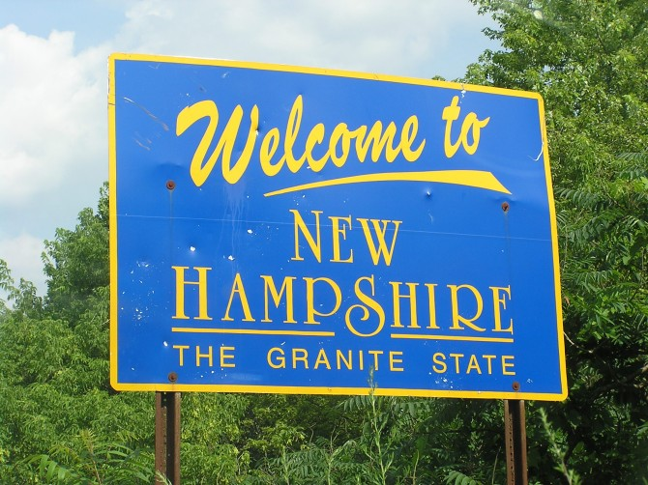
State Law

Slide 31
New Hampshire Lobbying Law
Registration: lobbyists must register with Secretary of State.
A “lobbyist” is employed for consideration by any entity other than the state:
to promote or oppose any legislation pending or proposed before the general court, or
any action by the governor, governor and council, or any state agency, where such action concerns legislation or contracts pending or proposed before the general court. (N.H. Rev. Stat. Ann. § 15:1)

Slide 32
New Hampshire Lobbying Law
Several exceptions, including:
Public testimony before a legislative committee or subcommittee.
A written document filed in the course of a public proceeding or any other communication that is made on the record in a public proceeding.
Communication made by a public official acting in the public official's official capacity.
Communication made in a speech, article, publication, or other material that is distributed and made available to the public, or through radio, television, cable television, the Internet, or other medium of mass communication.

Slide 33
New Hampshire Lobbying Law
Lobbyists must report expenditures, honoraria, political contributions, etc.
Use of public funds to lobby
State funds cannot be used to lobby or attempt to influence legislation, participate in political activity, or contribute funds to any engaged in these activities. (N.H. Rev. Stat. Ann. § 15:5).
Any recipient of a grant or appropriation of state funds that wishes to engage in any of these activities must physically and financially separate state funds from any non-state funds that may be used for any of these purposes.
Bookkeeping “separation” is not sufficient.

Slide 34
What if…

Slide 35
Scenario #1
You work for a non-profit organization that advocates for child safety. HB 123 would require children, aged 4-8, to be seated in a booster seat in motor vehicles. May you communicate with coalition members and other partners to let them know that HB 123 exists and answer questions about its impact?
Yes. There is no call to action here. But what if you encourage coalition members to contact the legislature in support of the bill?

Slide 36
Scenario #2
The state holds a public hearing to consider granting local control of smoke-free policy. May a smoke-free coalition that is funded with federal grant dollars inform the public about the hearing and urge people to attend if they are passionate about the issue?
It depends. Notifying the public of a legislative hearing is not lobbying. However, if the coalition urged the public to support the bill or otherwise took a side, it would constitute impermissible lobbying.
Also, the coalition may notify its members and urge them to testify since that would not be a communication with the public.

Slide 37
Scenario #3
May a federally funded nonprofit organization accept an invitation from a state legislative committee to present research findings at an upcoming bill hearing?
Yes. A research analysis does not constitute lobbying. The analysis may also include evidence of policy effectiveness (e.g., decreased smoking rates in jurisdictions with comprehensive clean indoor air laws).
The nonprofit grantee must receive a formal, written request to testify.

Slide 38
Contact Kerri McGowan Lowrey, J.D., M.P.H. klowrey@law.umaryland.edu (410) 706-5994

Slide 39
NH Public Health Association
Lobbying and Advocacy:
A Primer for New Hampshire Non-Profit Advocates
February 15, 2018
James Monahan, The Dupont Group

Slide 40
RSA 15: NH Lobbyist Law
Scope
Registration
Identification
Disclosure
http://www.gencourt.state.nh.us/rsa/html/I/15/15-mrg.htm

Slide 41
RSA 15: Scope
Applies if you are being paid to advocate before the NH Legislature
Some Limited Application at the Executive Level
Procurements
At Agency Level RSA 541-A – administrative procedures act applies

Slide 42
RSA 15: Registration
Who must Register
Exemptions
Those employed to promote or oppose legislation pending or proposed before the general court
Limited Executive and State Agency Activities
Administrative rules
Procurement
Governor and Council
Registration Form
Name, client name, address, field of business, nature of advocacy
$50 fee
Adjudicated proceedings under the Administrative Procedures Act (RSA 541-A)
Businesses seeking to do business with the State
Communcations
Public testimony
Written communications
Media for news purposes
(Protected) public speech
Communications with Gov’t

Slide 43
RSA 15: Disclosure
Name Tags
Lobbyist Financial Disclosure Statements
Fees
Expenditures
Honorarium, gifts and political contributions
Public document
Due quarterly
Filed with the Secretary of State and enforced by the Attorney General

Slide 44
Some Informal Rules of The Road
Know the rules and procedures
Respect the office and the process
Let members know who you are and who your clients are
Always be honest
Understand the other side’s position
There are no 9th innings

Slide 45
Questions and Answers

Slide 46
Closing
NHPHA 2018Legislative Priorities
NHPHA expansion of workforce development activities
Join us!
Evaluations
Thank you – speakers, IHPP, NEPHTC

